Slide 1
Your ESD Flooring Solution Provider
8400 Series Static Control Vinyl Tile Interlocking Flooring System
StatguardFlooring.com

Slide 2
Why FreeStyle 8400™ Interlocking Floor System is the Preferred Flooring System?
FreeStyle 8400™ saves: Time, Money, and Disruption
Easy to install, no messy glue or adhesive required
Suitable for use over high-moisture, irregular, and problem subfloors
Less downtime for your facility
Floor can be used IMMEDIATELY!
StatguardFlooring.com

Slide 3
Why FreeStyle 8400™ Interlocking Floor System is the Preferred Flooring System?
FreeStyle™ is the Environmentally Smart Choice, Conductive Interlocking Base is manufactured with a minimum of 20% recycled materials
The only conductive flooring of its kind that can contribute to LEED™ Points
Possessing LEED™ Points or a LEED certification indicates that your organization exhibits an environmental consciousness, which can potentially equate to tax credits and or exemptions
StatguardFlooring.com

Slide 4
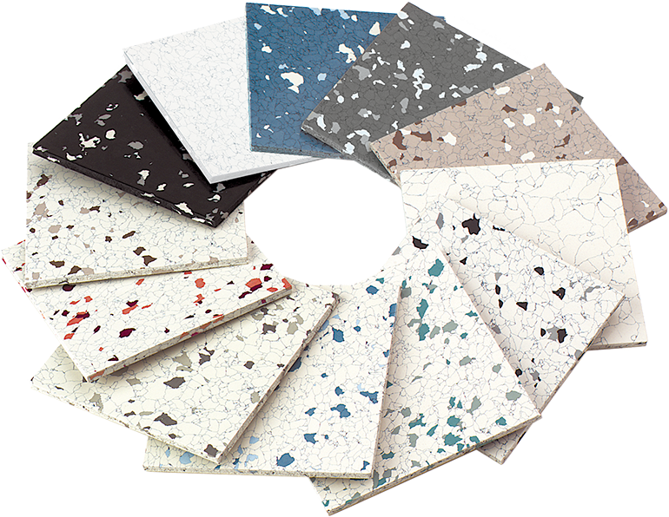
8400 Series Statguard® Vinyl Floor Tile
Conductive - Electrical Resistance: < 1 x 10⁶ ohms
Dissipative - Electrical Resistance: 1 x 10⁶ to < 1 x 10⁹ ohms
Interlocking Tile Dimensions: 18.5” x 18.5”
Interlocking Tile Thickness: 0.34”
Lifetime electrical warranties and certified testing
Ten year limited wear warranty
Color extends throughout the tile
Meets ANSI/ESD S20.20-2014 flooring required limit tested per ANSI/ESD STM7.1 and ESD TR53, and is suitable flooring component for personnel grounding Footwear / Flooring System.
Grounding:
Concrete Floor: Every 1,000 Sq. Ft
Access Floor: Every 3,000 Sq. Ft
Interlocks provide tile-to-tile electrical connection
StatguardFlooring.com

Slide 5
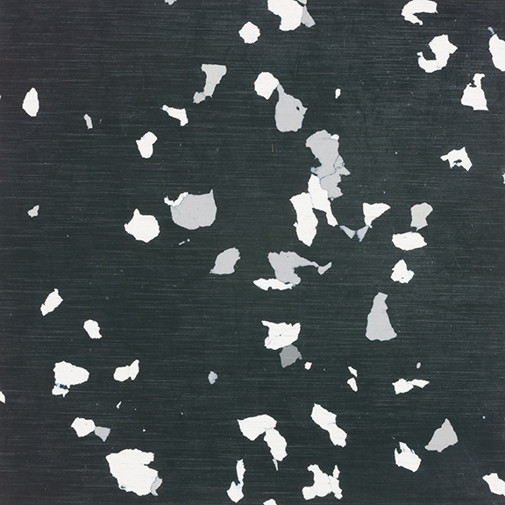
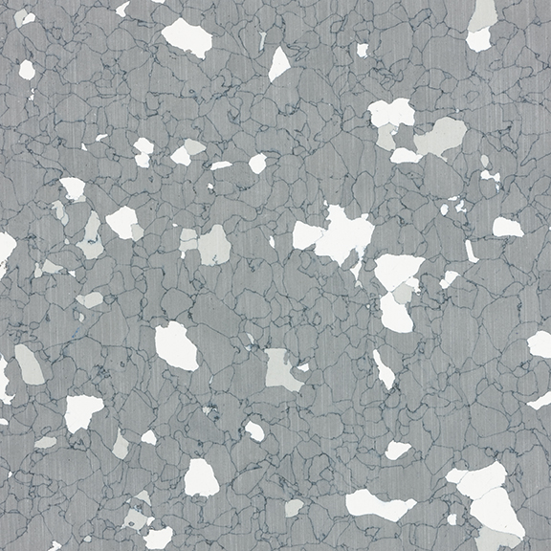
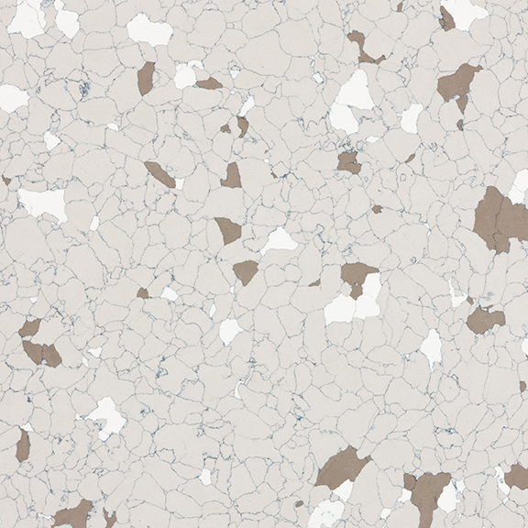
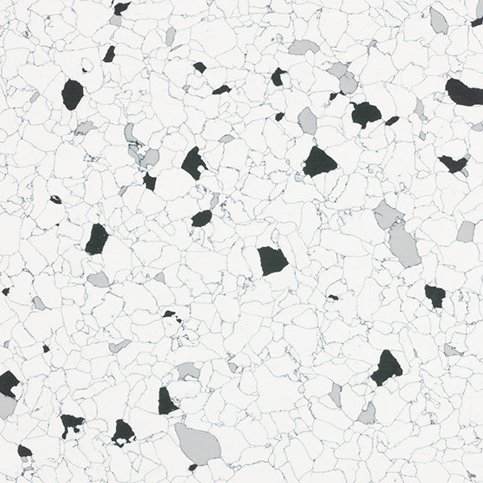
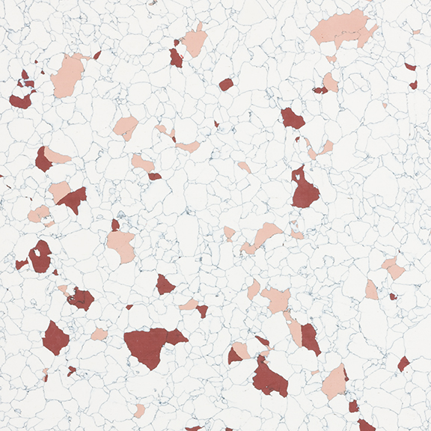
Tile Colors Available
Reverse Black
Reverse Blue
Reverse Grey
Reverse Brown
Black
Maroon
Green
Blue
Grey
White
Brown
StatguardFlooring.com

Slide 6
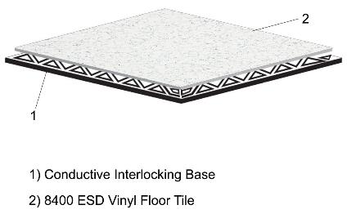
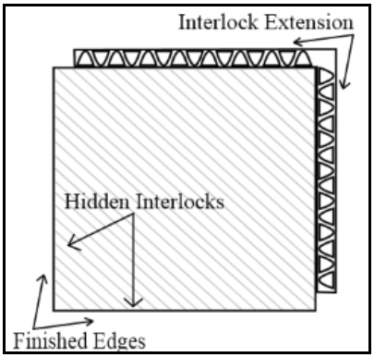
8400 Series Static Control Vinyl Tile Interlocking Floor System - The Complete Flooring Solution
FreeStyle 8400™ with Statguard 8400 Series Vinyl Tile
SelecTech patented FreeStyle Interlocking System
FreeStyle 8400™ Series is made with the Statguard 8400 conductive vinyl
This conductive vinyl surface has a more vinyl-rich composition, which gives it a brighter finish and makes it easier to scrub and buff back to a shine if it gets abused (which is often in most factory environments)
The 8400 series comes in a wider variety of colors, providing more choices to the design needs of your environment.
StatguardFlooring.com

Slide 7
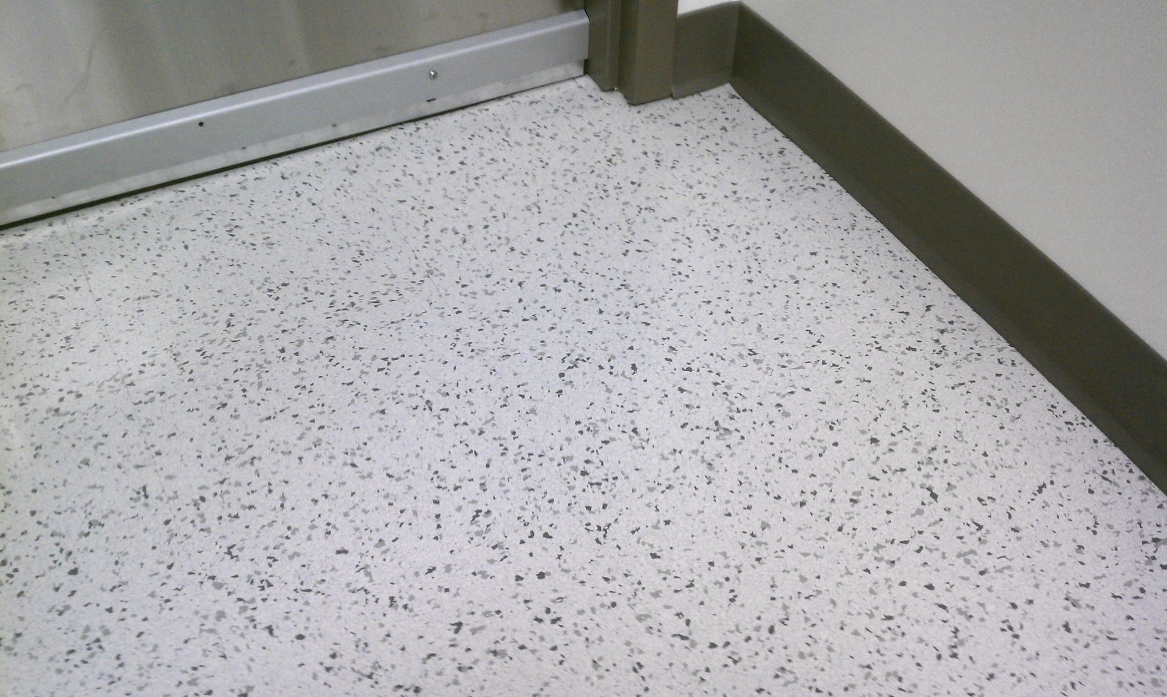
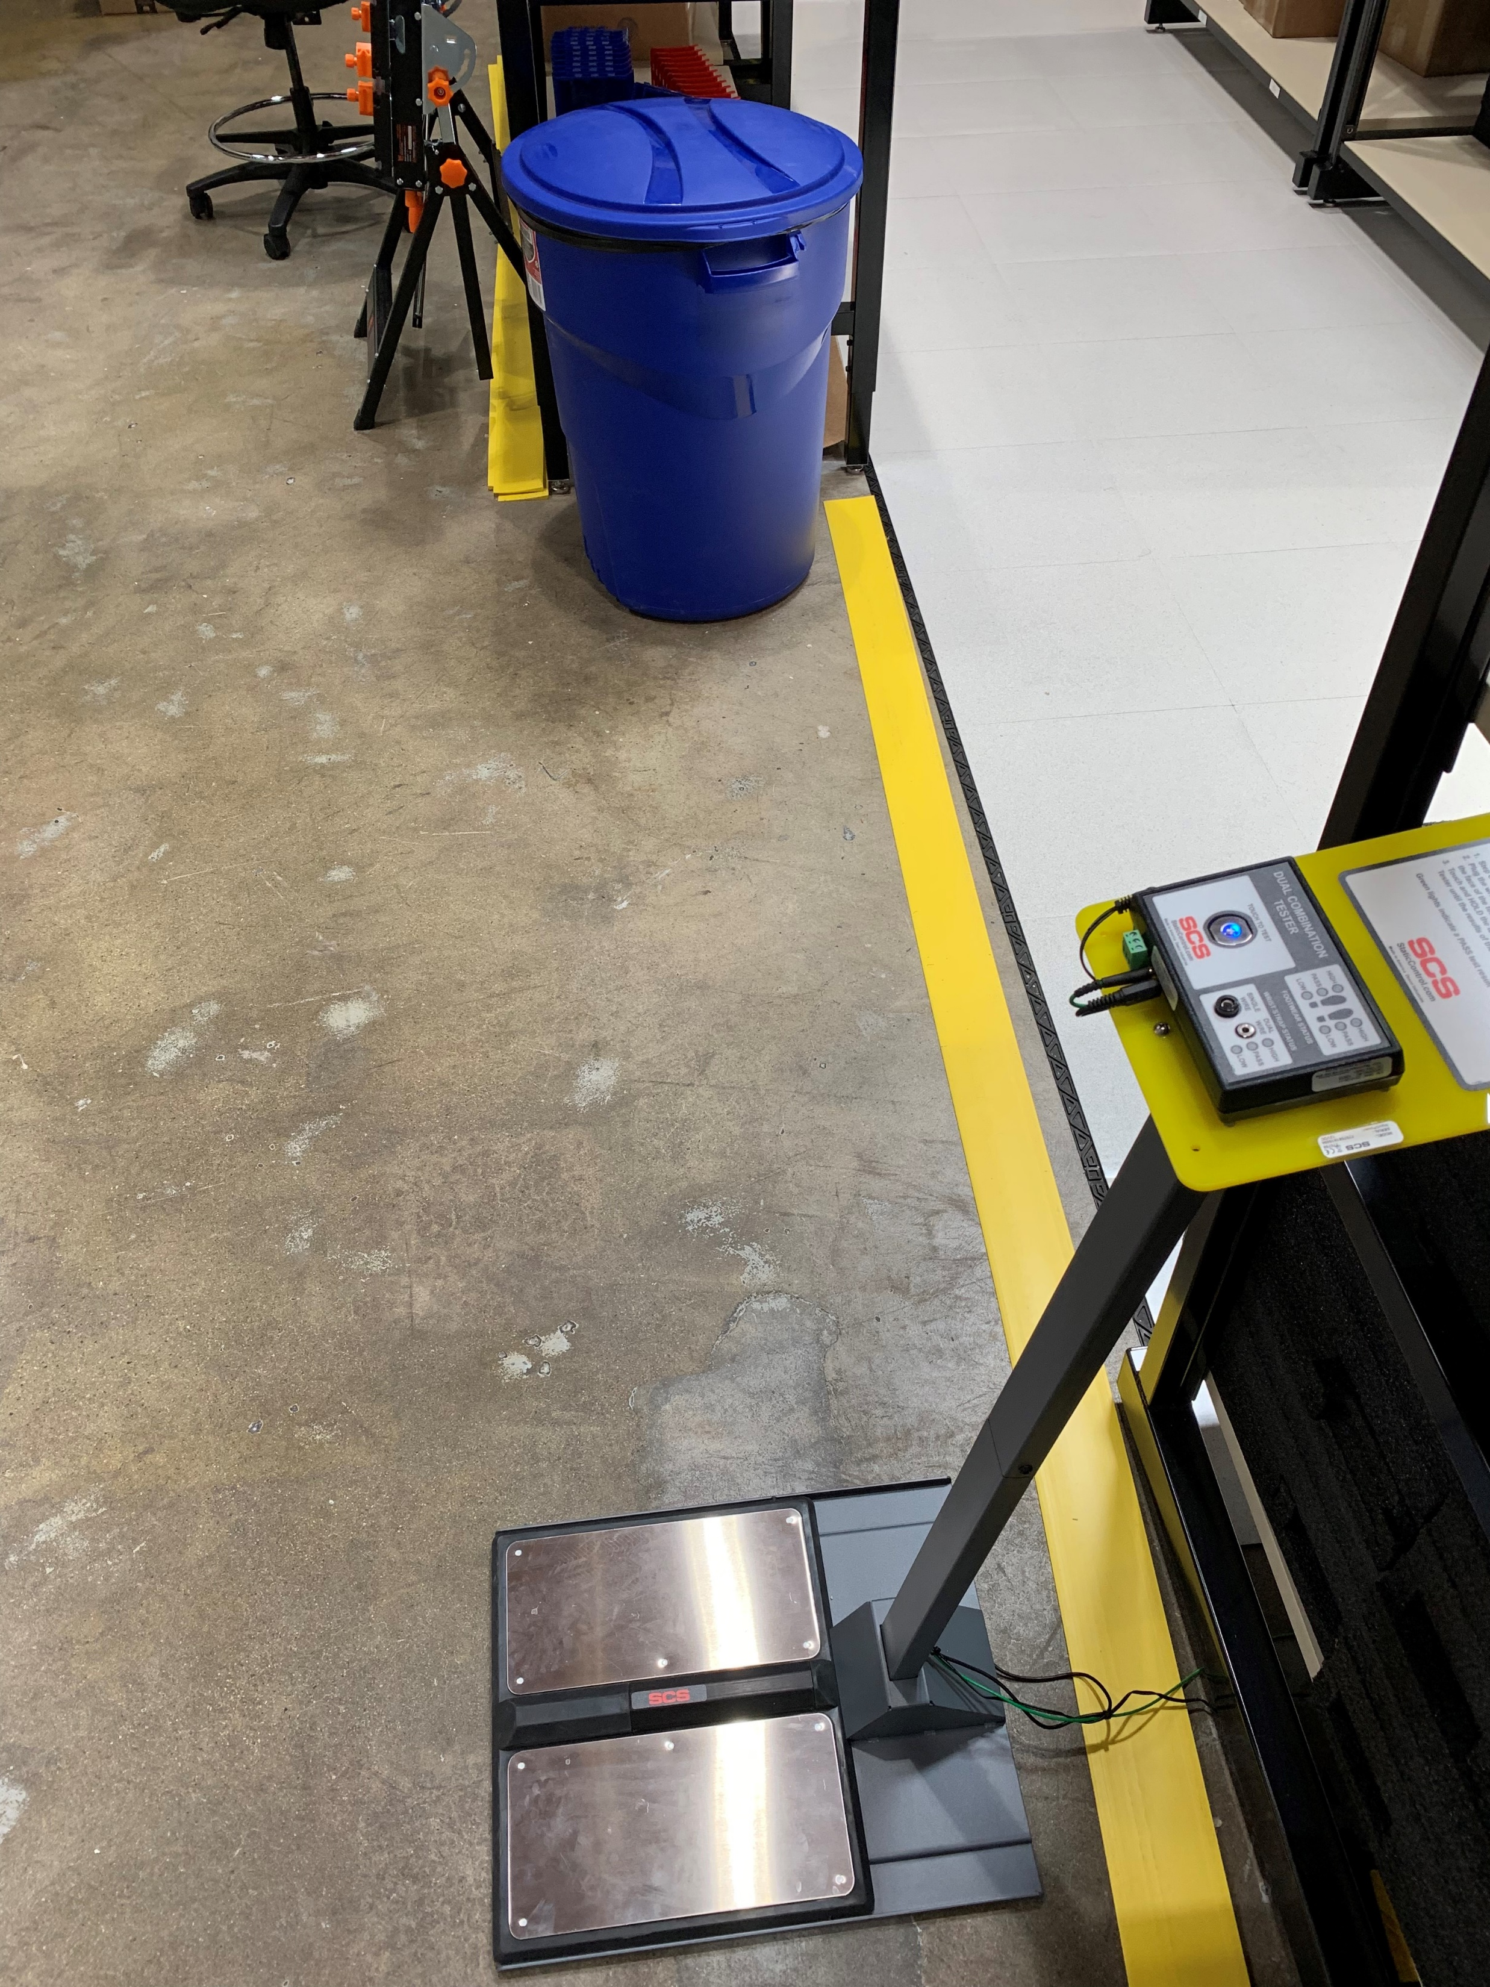
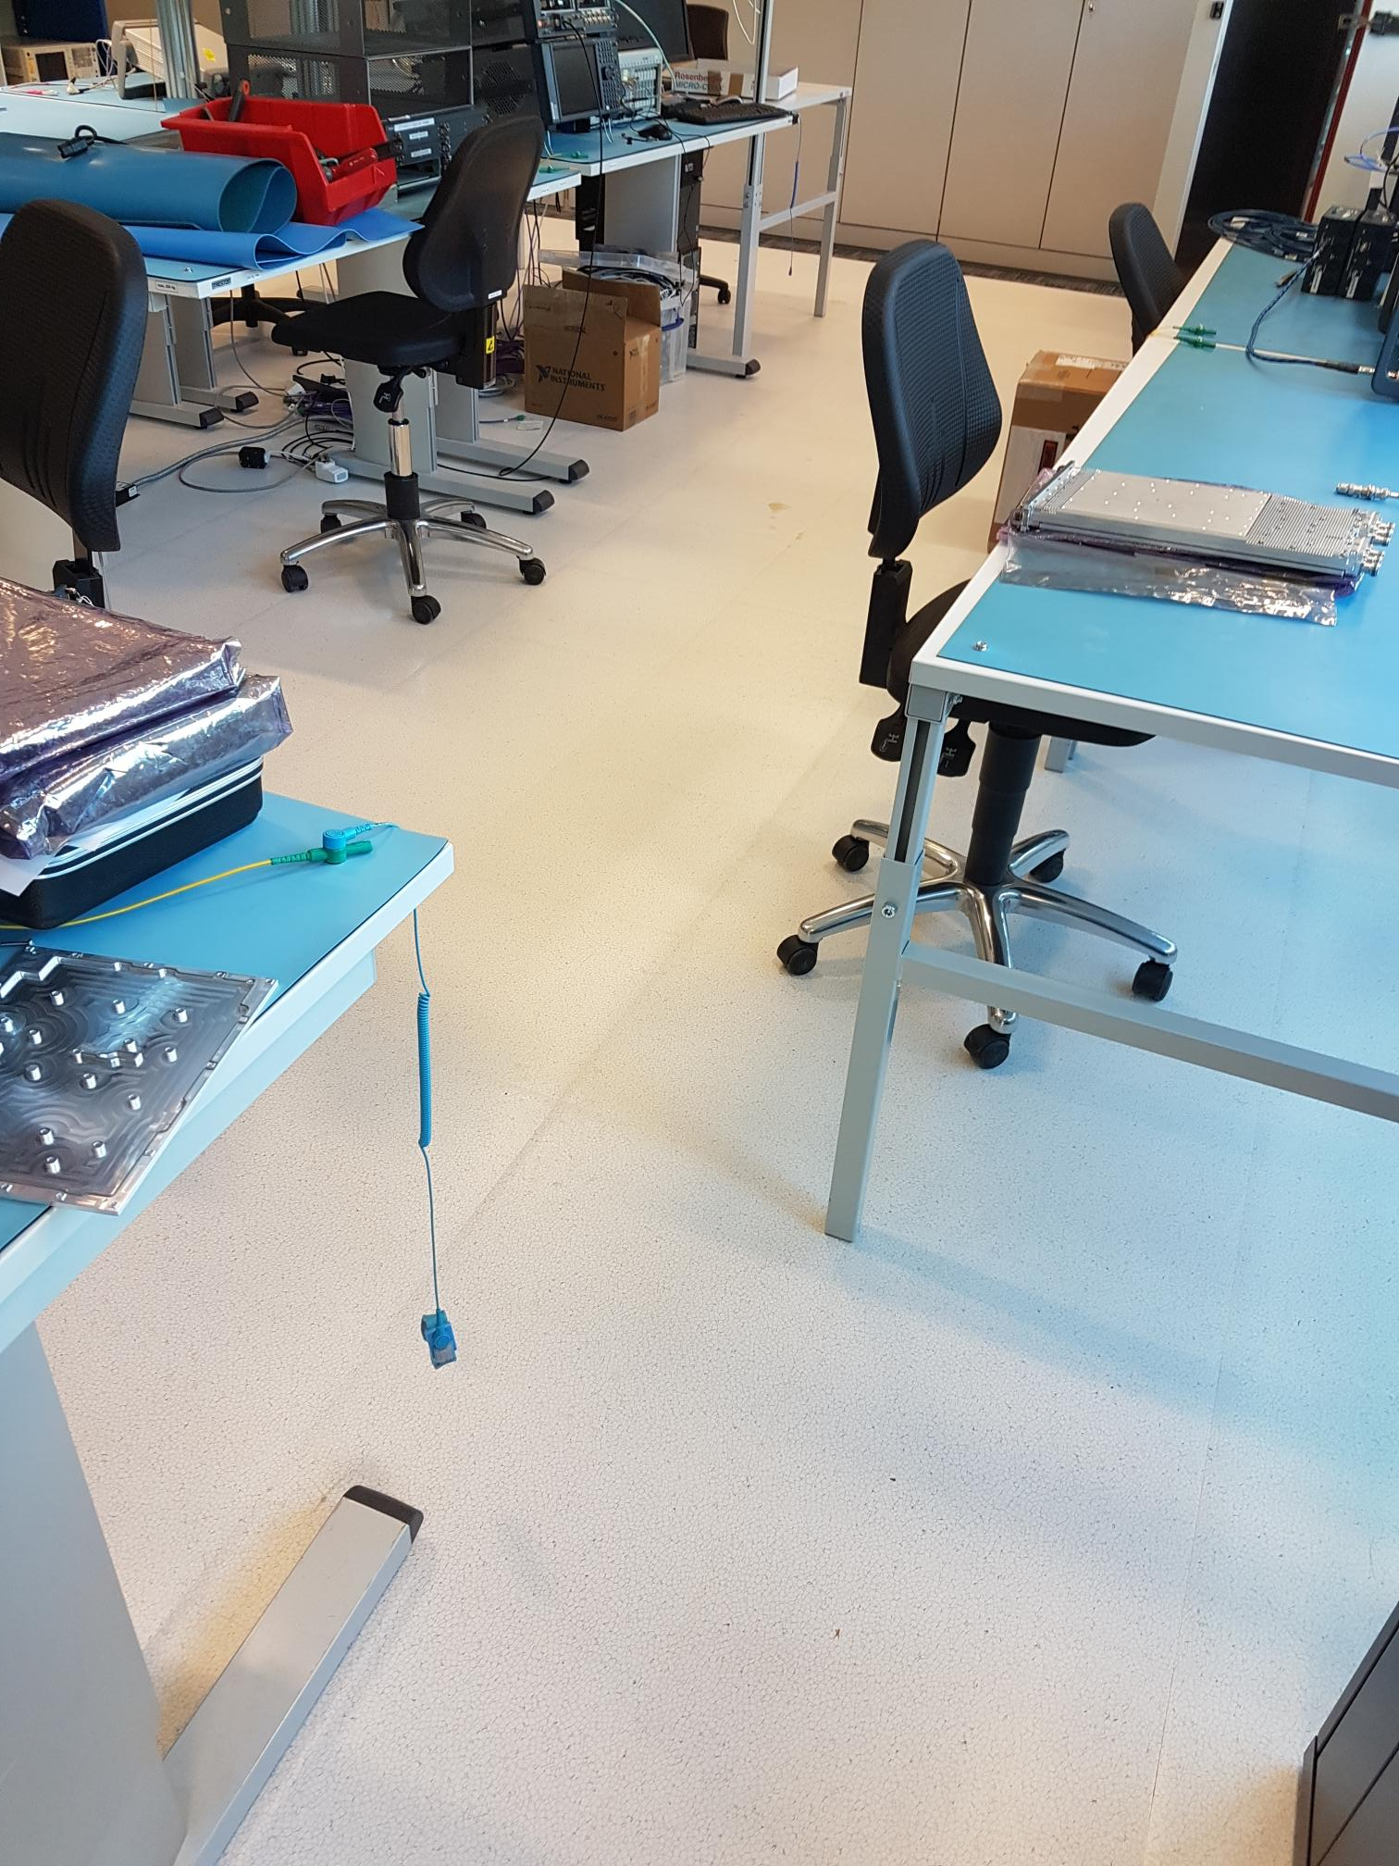
Ideal Applications
Static Control
Leased or Rented Space
Access Floors
Problem Installations
Renovations
StatguardFlooring.com

Slide 8
For More Information
1 Colgate Way
Canton, MA 02021 USA
(781) 821-8370
Service@StatguardFlooring.com

